Slide 1


Goldwell Handyman Services

Slide 2

Goldwell Handyman Services
Mr. David Yu
Mr. Kidus Joseph
Mr.Krunal Solanki
Mr. Justin Chung
Mrs. Aigiun Guseinova
IS 602 Management of Information Systems

Slide 3
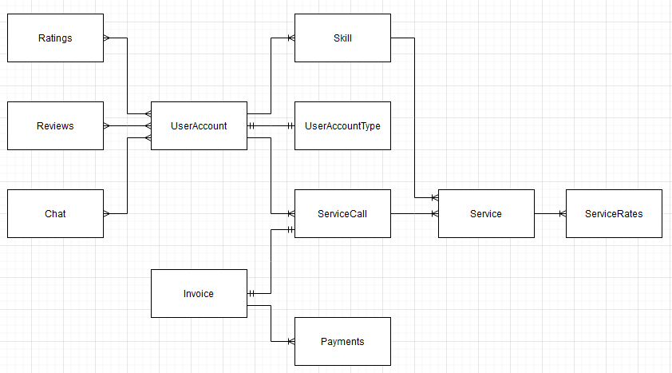
ERD Diagram

Slide 4
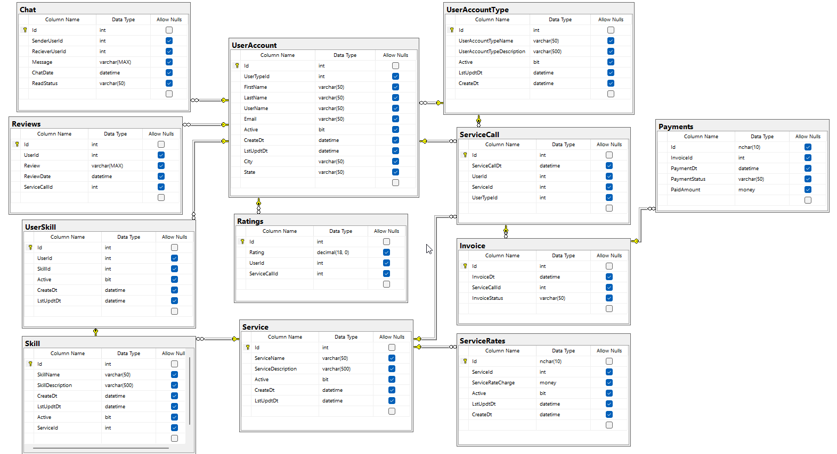
Database Diagram

